Slide 1
Data Science
Explained for Beginners
What is data science?
What are it’s applications?
Why is it trending now?
What are the tools for data science?

Slide 2
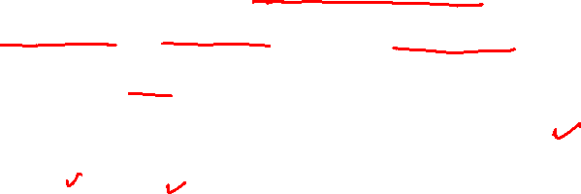
Data Science
Data science is an interdisciplinary field focused on extracting knowledge from data sets, which are typically large (Wiki)
Data science is a concept to unify statistics, data analysis, machine learning and their related methods in order to understand and analyze actual phenomena with data (Wiki)
Data science, or data-driven science, uses big data and machine learning to interpret data for decision-making purposes (Investopedia)

Slide 3
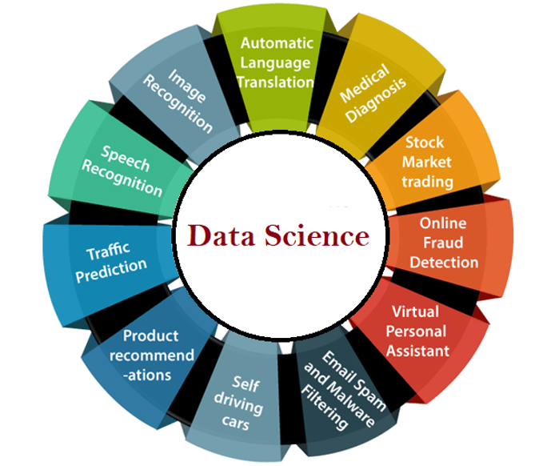
Applications

Slide 4
Trend?
Availability of data
Availability of computational power
Availability of stable software stack

Slide 5
Learning from Data
Regression
Classification
Clustering
Reinforcement Learning

Slide 6
Software
Matplotlib, Seaborn, Bokeh
Pandas
Scikit-learn
TensorFlow
Torch
MXNet
Spark

Slide 7
Cloud Computing
Amazon Web Services (AWS)
Google Cloud Platform (GCP)
Microsoft Azure

Slide 8
Data Science Pipeline
Data Collection
Data Preparation
Model Selection
Model Training
Model Evaluation
Deployment and Incremental Training

Slide 9
Website : www.aisciences.io

